Slide 1
Making this resource work for you
Prior to teaching this lesson, please refer to the ‘Unit Overview and Planning Document’.
Further guidance on planning Science Mastery lessons can be found in the detailed planning guidance document.
Refer to the ‘notes’ section on each slide for useful information, including suggested expositions, pedagogical content knowledge, suggested questions, answers and more. Consider using presenter mode so you can see this guidance throughout the lesson.
The introduction slides can be adapted to suit your teaching style and the needs of your class.
Before the lesson, adapt the fix-it slide to address any misconceptions identified in the previous lesson’s exit ticket.
Choose from the suggested activities to suit your class. The intention is not that you complete all of these, but that you select those which ones are most appropriate for your students. It may be appropriate to further adapt activities for your students.
These lessons are designed to occupy approximately 1 hour. To adapt for a shorter or longer lesson duration we advise you to adapt the activity section accordingly.
Please consider using the final slide to send feedback about this lesson or examples of PowerPoints that you have adapted to our design team. Your feedback is used to improve Science Mastery for all of our teachers and students. We appreciate all suggestions and comments.
Thank you for reading!
The Science Mastery Team

Slide 2
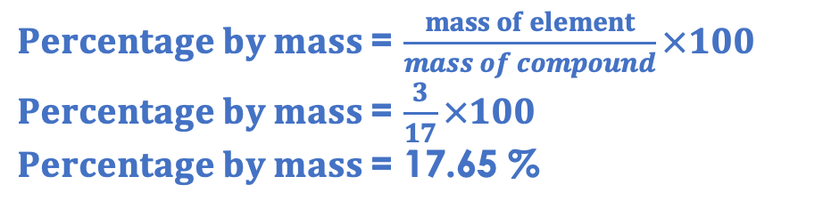
Taking it Further: Volumes of Gases
Answer the questions below.
State the unit of volume in chemistry.
Convert 50 cm³ to dm³.
State the number of particles in 1 mole of a substance.
Calculate the relative formula mass of ammonia (NH₃).
Calculate the percentage by mass of hydrogen in ammonia.
dm³
0.05 dm³
6.02 x10²³
14+(3x1) = 17
$Percentage by mass$= $\frac{mass of element}{mass of compound}×100$
$Percentage by mass$= $\frac{3}{17}×100$
$Percentage by mass$= 17.65 %
Notes:
Big idea: Reactions rearrange matter
Foundation: Calculate the mass in grams of 1 mole of ammonia (NH₃).
Stretch: Calculate the number of atoms in 1 mole of ammonia.
Answers:
Foundation: 17 g
Stretch: 1 mole = 6.02 x10²³ molecules, 4 atoms per molecule = 2.408 x10²⁴

Slide 3
Taking it Further: Volumes of Gases
Do Now:
State the unit of volume in chemistry.
Convert 50 cm³ to dm³.
State the number of particles in 1 mole of a substance.
Calculate the relative formula mass of ammonia (NH₃).
Calculate the percentage by mass of hydrogen in ammonia.
Drill:
Calculate the relative formula mass of methane (CH₄).
Calculate the mass of 1 mole of methane.
Calculate the number of moles in 48 g of methane.
Notes:
Drill answers:
12+(4x1) = 16
n = m/Mr, so m = nxMr, 1 x 16 = 16 g
n = m/Mr, so n = 48/16 = 3 mol

Slide 4
Taking it Further: Volumes of Gases
Read Now:
Avogadro’s law states that one mole of any gas has the same volume. This is because one mole of any substance contains 6.02 x 10²³ particles. For some gases, such as the Noble gases, 1 mole of gas contains 6.02 x 10²³ atoms. For other gases, such as carbon dioxide or oxygen (O2), 1 mole of gas contains 6.02 x 10²³ molecules. As the mole is the number of particles present, if there are the same number of particles present, they will occupy the same volume of space. This law applies if gases are at standard temperature and pressure, which is room temperature (20ºC) and 1 atmosphere (atm) of pressure. You should remember from physics that temperature and pressure both affect the volume of a gas, so these must remain constant for 1 mole of two different gases to have the same volume.
State Avogadro’s Law.
State the number of particles found in one mole of a substance.
Describe the conditions of standard temperature and pressure.
Describe the two factors that must remain constant for Avogadro’s law to apply.

Slide 5
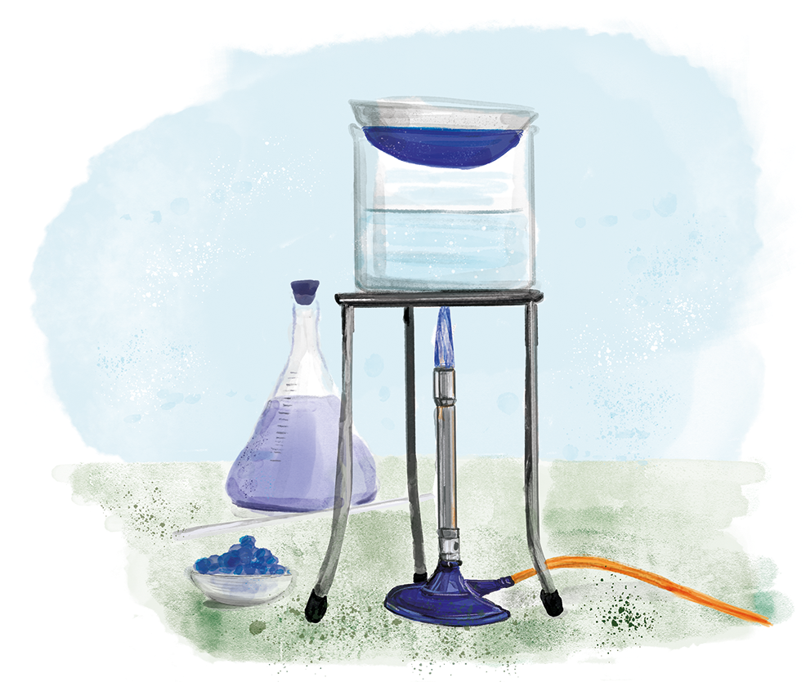
C4.3.15
15/11/2023
Taking it Further: Volumes of Gases
C4.3.1 Prior Knowledge Review
C4.3.2 (HT) Introducing the Mole
C4.3.3 (HT) Mole Calculations
C4.3.4 PKR: Concentration
C4.3.5 TIF: Calculating Concentration
C4.3.6 TIF: Calculating an Unknown Concentration
C4.3.7 (HT) Amounts of Substances in Equations
C4.3.8 (HT) Limiting Reactants
C4.3.9 PKR: Reactions of Acids
C4.3.10 Acids, Alkalis and Neutralisation
C4.3.11 TIF: Acid-Alkali Titration
C4.3.12 TIF: Acid-Alkali Titration Analysis
C4.3.13 TIF: Titration Calculations
C4.3.14 (HT) Strong and Weak Acids
C4.3.15 TIF: Volumes of Gases
Notes:
Big idea: Reactions rearrange matter
In this final lesson of the unit, which is chemistry only, students will look at the volumes of gases, applying calculations to balanced equations.
Suggested Hook:
What two factors (from P4.2) affect the pressure of a gas?
What is the relationship between temperature and gas pressure?
What is the relationship between gas pressure and volume?

Slide 6

Following this lesson, students will be able to:
State the volume of 1 mole of gas at room temperature and pressure.
Calculate the volume of different numbers of moles of a gas.
Use chemical equations to calculate volume and number of moles of gas
Key Words:
volume
mole
molar volume
rtp
pressure
temperature
Notes:
Guidance:
See unit overview document and planning guidance to see how these objectives are typically assessed at GCSE, including examples of what students should be able to do following this lesson.
Planning for different needs:
The learning objectives given on this slide are suggested based on the most common requirements for exams, however they can be adapted based on the needs of different classes.
For best practice, the unit preparation booklet should be used to determine the appropriate focus of lessons within the unit.
While it is not possible to explicitly split content into levelled grades, we recommend that lesson objectives can be classified as critical, core or stretch.
Critical: the content or skill is essential for all students to be able to progress.
Core: the content or skill is important for students to progress, but other opportunities may be available to revisit it.
Stretch: the content or skill may not be essential for all students but is important for students aiming for the highest grades.
Key skill: this is a crucial skill being developed in this unit as part of the skill mapping
C4.3.15 Lesson Objectives:
Critical: State the volume of 1 mole of gas at room temperature and pressure.
Core: Calculate the volume of different numbers of moles of a gas.
Stretch: Use chemical equations to calculate volume and number of moles of gas

Slide 7
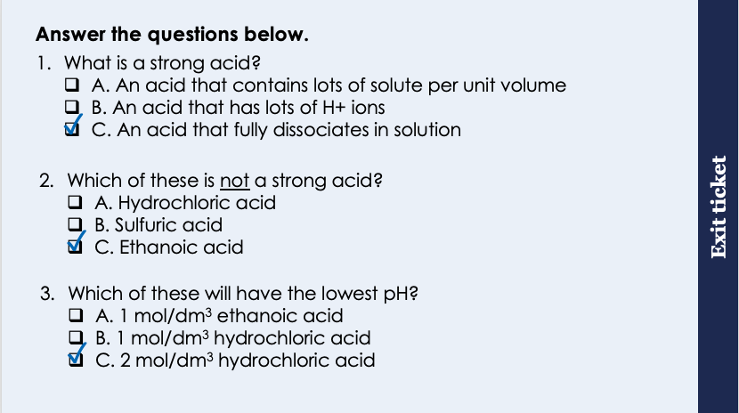
This is the fix-it portion of the lesson
The fix-it is an opportunity to respond to gaps in knowledge, especially those identified by the pre-unit quiz.
The teacher should customise this slide as needed, to facilitate
reteach, explanation, demonstration or modelling of ideas and concepts that students have not yet grasped or have misunderstood.
practise answering specific questions or of key skills.
redrafting or improving previous work.
Notes:
Purpose: to spend time on any gaps identified in previous learning from exit ticket.
Fix-it guidance from previous exit ticket:
Q1. Answer: C
If students answer A, it suggests they have confused strength and concentration. To fix it, get students to define each. If students answer B, they have recognised that there is a relationship between strength and H+ ions, but this is not specific enough as it could also refer to concentration. To fix it, get students to define strong and weak acids and explain the two factors that affect the pH of an acid.
Q2. Answer: C
If students answer A or B, they have not recognised the strong and weak acids. To fix it, review the definitions and examples of each.
Q3. Answer: C
If students answer A, they have confused the lowest pH with the highest pH, assuming that lowest is ‘the least/lowest acidity’ rather than lowest pH. If students answer B, they have not recognised the relationship between concentration and pH. To fix it, get students to explain the two factors that affect the pH of an acid.

Slide 8
Reacting Gases
Higher Tier only
One mole of any substance contains the same number of particles.
One mole of a gas occupies the same volume as one mole of another gas.
Molar volume is the volume occupied by one mole of gas at room temperature (20 ºC) and pressure (1 atmosphere).
At room temperature and pressure (rtp) molar volume is 24 dm³.
For example:
H₂(g) + Cl₂ (g) → 2 HCl (g)
Notes:
Suggested exposition:
We know that one mole of any substance contains the same number of particles. If these substances are gases, and are at the same temperature and pressure, this same number of particles will occupy the same volume of space. This is Avogadro’s Law: when the temperature and pressure remain constant, the same volume of different gases contains an equal number of molecules.
So one mole of hydrogen occupies the same volume as one mole of oxygen, or one mole of carbon dioxide.
This volume that is occupied by one mole of any substance is described as the molar volume. At room temperature (20 ºC) and pressure (1 atmosphere of pressure), this molar volume is 24 dm³. This is equal to 24 000 cm³. Just like when we’re calculating volume of liquids, we use the same units of volume (dm³) and sometimes might need to convert from cm³ to dm³.
How big is 24 dm3? A cube with sides of just over 29 cm long has a volume of just over 24 dm3 (24,389 cm3), so it is actually not that big!
It is essential that temperature and pressure remain constant, otherwise the volumes of different gases will not be equal. Remember from P4.2 that gas pressure is related to the volume and temperature of a gas.
We can use Avogadro's law to calculate the volumes of gases involved in reactions, as the chemical equations show the respective mole ratios of the reactants and products.
For example, hydrogen and chlorine gas can react to form hydrogen chloride gas.
We can see from the equation that the mole ratio of hydrogen to chlorine is 1:1, so in terms of moles, 1 mole of hydrogen would react with 1 mole of chlorine. As we know that one mole of a gas occupies the same volume, we can also say that a volume of hydrogen will react with the same volume of chlorine, as they would contain the same number of moles. So 1 dm³ of hydrogen would react with 1 dm³ of chlorine, or 50 dm³ of hydrogen would react with 50 dm³ of chlorine. There is a 1:1 mole ratio.
There is not a 1:1 ratio between hydrogen and hydrogen chlorine. 1 mole of hydrogen reacts to form 2 moles of hydrogen chloride. In terms of volume, this means that 1 dm³ of hydrogen would produce 2 dm³ of hydrogen chloride, or 50 dm³ of hydrogen would produce 100 dm³ of hydrogen chloride.
What volume of hydrogen chloride would be formed if 75 cm³ of chlorine reacted?
150 cm³.
We can use this method if we have multiple gas reactants or products. However, often we will be given mixed chemical equations, where there may only be one gas.

Slide 9
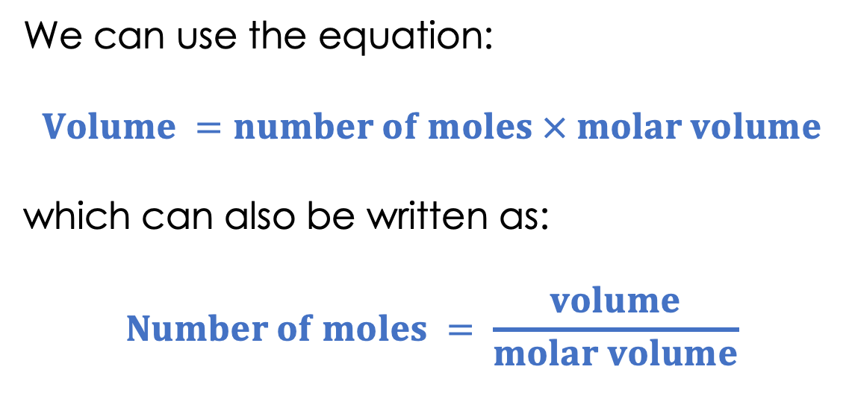
Moles and molar volume
Higher Tier only
Molar volume at room temperature and pressure is 24 dm³.
We can use this to calculate the volume of a known amount of substance.
We can use the equation:
$$Volume =number of moles × molar volume$$
which can also be written as:
$$Number of moles = \frac{volume}{molar volume}$$
Notes:
Suggested exposition:
So at a given temperature and pressure (as long as those are the same) one mole of any gas occupies the same volume. At room temperature and pressure, which we write as rtp and is 20 ºC and 1 atmosphere of pressure, this molar volume is 24 dm³.
If we know that conditions are room temperature and pressure, we can use this molar volume to calculate either the volume of gas that will be reacting or produced or the number of moles that will be reacting or produced.
The volume of a known number of moles of gas can be calculated using the equation: Volume = number of moles X molar volume.
This can also be written as number of moles = volume/molar volume.
Note: it can be easier for students to remember with the subject as number of moles as it is most similar to number of moles = mass/Mr.
Volume is measured in dm³ in both cases and amount of substance is measured in mol.
Just like when we are calculating number of moles and mass, and we can calculate relative formula mass from the periodic table, this molar volume is also information that we already know, provided the reaction or the gas is at room temperature and pressure.

Slide 10
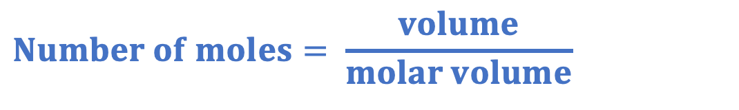


Worked Example
Higher Tier only
A scientist has 0.25 moles of oxygen at room temperature and pressure.
What is volume of this oxygen?
$$Number of moles= \frac{volume}{molar volume}$$
$$0.25= \frac{volume }{24}$$
$$Volume=6 dm 3$$

Slide 11
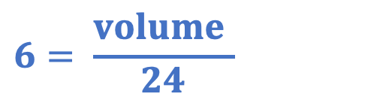
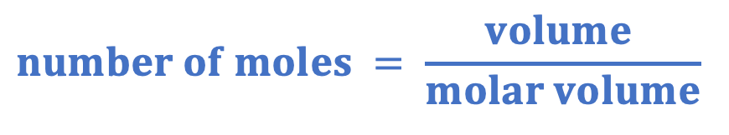

Worked Example
Higher Tier only
We can also apply this equation given a balanced chemical reaction.
Sodium azide (NaN₃) decomposes when heated to form sodium and nitrogen:
2 NaN₃ (s) → 2 Na (s) + 3 N₂ (g)
If 4 moles of sodium azide decomposes, what volume of nitrogen is formed?
$$number of moles = \frac{volume }{molar volume}$$
Mole ratio = 2:3
Number of moles of nitrogen = 6 mol
$$6= \frac{volume }{24}$$
$$Volume=144 dm 3$$
Notes:
Suggested exposition:
We can also use molar volume when given balanced chemical reactions, just like when we calculate reacting masses or limiting reactants.
For example, sodium azide (NaN3) decomposes when it is heated to form sodium and nitrogen.
Which of these substances will we be able to apply molar volume to?
Nitrogen. It is the only gas.
We can use a very similar method to calculating reacting masses.
If 4 moles of sodium azide breaks down, what volume of nitrogen will be formed?
The first thing we need to do is look at the molar ratio between sodium azide and nitrogen.
Sodium azide 2: 3 nitrogen
So if we know that 4 moles of sodium azide reacted, how many moles of nitrogen will be formed?
You may want to remind students at this point of the mole ratio calculation: x (x3/2 in this case).
6 moles of nitrogen will be formed.
Then we can use the equation to calculate the volume of nitrogen that would be formed.
What have we assumed in this case?
That this is taking place at room temperature and pressure! Normally it will say so in the question.

Slide 12

Is this correct?
50 g of oxygen will occupy the same volume as 50 g of carbon dioxide
Notes:
This is a common misconception where students confuse mass and number of moles. From L4, they should be aware of the relationship between mass and number of moles, but it can be useful to review if lots of students get this wrong.
This is incorrect.
If this was 50 moles of oxygen compared to 50 moles of carbon dioxide, they would occupy the same volume. These different gases have different relative formula masses, so a different number of moles would be present in each, therefore they would occupy different volumes.
You may wish to show students the working for this, to prove why it is not correct.
number of moles O₂= 50/32 = 1.56 mol
volume of O₂ = 1.56 x 24 = 37.5 dm³
number of moles CO₂= 50/44 = 1.136 mol
volume of CO₂ = 1.136 x 24 = 27.27 dm₃
Suggested guidance:
Talk tasks can be used in a variety of ways to suit the particular needs of the students you are teaching. Through exchanging views with others, students develop their understanding of the science beyond what could be achieved individually.
Science classrooms that successfully integrate talk have the following features:
Science talk is a regular feature of lessons and is woven into classroom activities.
Students are paired or grouped strategically by the teacher to ensure productive interaction. This might take into consideration the students’ proficiency of the English language, how encouraging they might be to peers and their attainment in the topic. It’s a good idea to consider these pairings in the class seating plan.
Students are encouraged and supported to talk, but are not forced to talk.
The teacher should take on the role of a facilitator, engaging with conversations where necessary and encouraging or steering the conversation where needed.
Students are encouraged to use the language they have to express their ideas (e.g., everyday language, imperfect English, native language), but also to incorporate science specific terminology where this is more accurate or has been taught.
6. Scientifically inaccurate ideas are not dismissed by the partner or teacher; open discussion and further investigation are relied on to help students construct ideas that support them to progress in their scientific understanding.
7. Guidelines for behaviour during talk tasks are explicit and frequently reviewed. Rules for students might be:
Listen carefully to your partner
Take turns talking.
Speak one at a time, without interrupting.
Politely agree or disagree and explain why.
Politely point out if your partner has used a scientific word incorrectly, if they have explained the science incorrectly, or if there is a more accurate way to describe something.
If confused, ask questions.
Stay focused on the discussion topic.
Respond to one another.

Slide 13
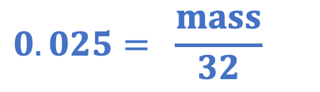
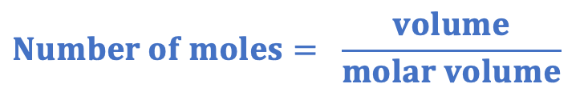
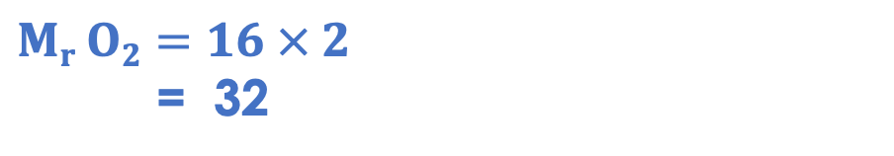
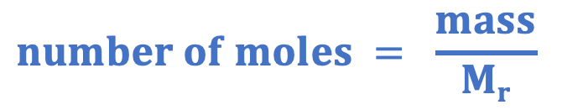
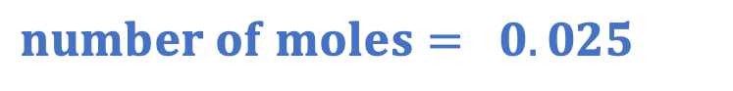
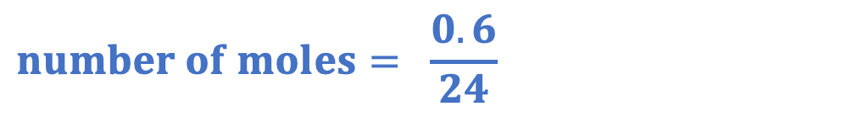
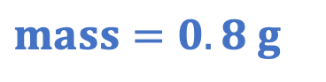
Discuss with your partner how you should solve this question. Work together to find the answer. A scientist has a sample of 0.6 dm³ of oxygen gas. What mass of gas is in the sample?
$$Number of moles= \frac{volume}{molar volume}$$
$$Mr O2=16 × 2$$
= 32
$$number of moles= \frac{0.6}{24}$$
$$number of moles = \frac{mass}{Mr}$$
$$number of moles= 0.025$$
$$0.025= \frac{mass}{32}$$
$$mass=0.8 g$$
Notes:
This is provided as a talk task before the I/We/You cycle as a practice for students to identify what information is given and what they might need to work out.
Suggested guidance:
Talk tasks can be used in a variety of ways to suit the particular needs of the students you are teaching. Through exchanging views with others, students develop their understanding of the science beyond what could be achieved individually.
Science classrooms that successfully integrate talk have the following features:
Science talk is a regular feature of lessons and is woven into classroom activities.
Students are paired or grouped strategically by the teacher to ensure productive interaction. This might take into consideration the students’ proficiency of the English language, how encouraging they might be to peers and their attainment in the topic. It’s a good idea to consider these pairings in the class seating plan.
Students are encouraged and supported to talk, but are not forced to talk.
The teacher should take on the role of a facilitator, engaging with conversations where necessary and encouraging or steering the conversation where needed.
Students are encouraged to use the language they have to express their ideas (e.g., everyday language, imperfect English, native language), but also to incorporate science specific terminology where this is more accurate or has been taught.
6. Scientifically inaccurate ideas are not dismissed by the partner or teacher; open discussion and further investigation are relied on to help students construct ideas that support them to progress in their scientific understanding.
7. Guidelines for behaviour during talk tasks are explicit and frequently reviewed. Rules for students might be:
Listen carefully to your partner
Take turns talking.
Speak one at a time, without interrupting.
Politely agree or disagree and explain why.
Politely point out if your partner has used a scientific word incorrectly, if they have explained the science incorrectly, or if there is a more accurate way to describe something.
If confused, ask questions.
Stay focused on the discussion topic.
Respond to one another.

Slide 14


True or false?
1 mole of gas at rtp occupies 24 dm³
Room temperature is 24 ºC
The volume of a gas can be calculated using molar volume divided by number of moles
Molar volume is the volume occupied by one mole of gas
2 moles of gas at rtp occupies 12 dm³
True
False
False
True
False
Notes:
Purpose: to check that key knowledge from the introduce phase has been learnt and understood.
You may wish to provide students with white boards to enable them to carry out calculations.
1T; 2F; 3F; 4T; 5F;

Slide 15
Drill
State room temperature.
State room pressure.
Explain what is meant by ‘rtp’.
Define molar volume.
State the unit of volume.
State molar volume at rtp.
State the equation that links volume, molar volume and number of moles.
Notes:
Purpose: This is a knowledge drill. The purpose of this is to check that the critical knowledge is secure before pupils move onto independent practice.
Suggested guidance: There are a range of ways this could be done depending on time and ability range of the class:
Mini whiteboards
As full sentences in exercise books
As short answers in exercise books
In the pupil workbook
As pair talk
As cold call

Slide 16
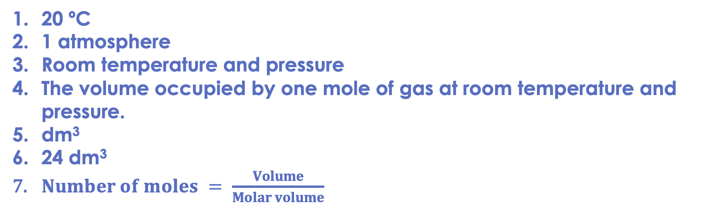
Drill answers
20 ºC
1 atmosphere
Room temperature and pressure
The volume occupied by one mole of gas at room temperature and pressure.
dm³
24 dm³
$Number of moles = \frac{Volume}{Molar volume}$
Notes:
Purpose: This is a knowledge drill. The purpose of this is to check that the critical knowledge is secure before pupils move onto independent practice.
Suggested guidance: There are a range of ways this could be done depending on time and ability range of the class:
Mini whiteboards
As full sentences in exercise books
As short answers in exercise books
In the pupil workbook
As pair talk
As cold call

Slide 17
I: Calculating volume of a gas
Nitrogen reacts with hydrogen to form ammonia, according to the equation:
N₂ (g) + 3 H₂ (g) → 2 NH₃ (g)
Calculate the volume of ammonia that could be made from 100 cm³ of nitrogen if hydrogen is in excess.
Mole ratio = 1 : 2
100 cm³ of nitrogen: 200 cm³ of ammonia
Calculate the volume of ammonia that could be made from 240 cm³ of hydrogen if nitrogen is in excess.
Mole ratio = 3 : 2
240 cm³ of hydrogen: 160 cm³ of ammonia
We can divide by 3 then multiply by 2 or multiply by 2/3
Notes:
Purpose: The I-We-You section aims to support pupils to build skills that they most commonly need when answering questions associated with this knowledge in the assessment. This section is also used to interleave other content we expect pupils to know at this stage of their education in order that they build a big picture of the science they are learning.
For the ‘I’ activity, the teacher should model how to answer the question. They can do this by narrating their thinking process aloud, and making links to learning earlier in the lesson explicit.
For the ‘we’ activity, the teacher and students work though a similar example together, in order to prepare students to be able to answer a similar question independently.
Opportunities for the ‘you’ activity – independent practise – occur in the activity portion of the lesson once the student is secure enough to process independently.

Slide 18

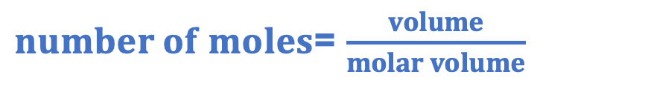
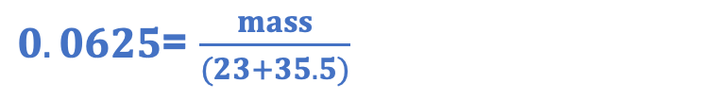
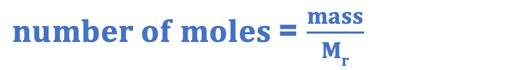
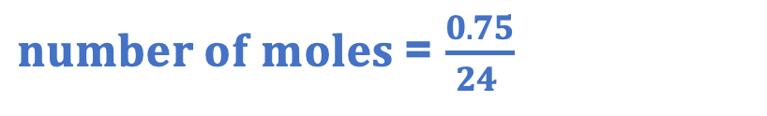
We: using volume of gas in an equation
Sodium reacts with chlorine to form sodium chloride, according to the equation:
2 Na (s) + Cl₂ (g) → 2 NaCl (s)
If 750 cm³ of chlorine reacted with excess sodium, how many moles of sodium chloride would be formed?
$number of moles$= $\frac{volume}{molar volume}$
$number of moles$= $\frac{0.75}{24 }$
$$number of moles=0.03125 mol$$
Mole ratio = 1 : 2
number of moles of sodium chloride = 0.0625 mol
What mass of sodium chloride would be formed?
$number of moles$= $\frac{mass}{Mr}$
$mass$= $3.66 g$
$0.0625$= $\frac{mass}{(23+35.5)}$
Notes:
Purpose: The I-We-You section aims to support pupils to build skills that they most commonly need when answering questions associated with this knowledge in the assessment. This section is also used to interleave other content we expect pupils to know at this stage of their education in order that they build a big picture of the science they are learning.
For the ‘I’ activity, the teacher should model how to answer the question. They can do this by narrating their thinking process aloud, and making links to learning earlier in the lesson explicit.
For the ‘we’ activity, the teacher and students work though a similar example together, in order to prepare students to be able to answer a similar question independently.
Opportunities for the ‘you’ activity – independent practise – occur in the activity portion of the lesson once the student is secure enough to process independently.

Slide 19
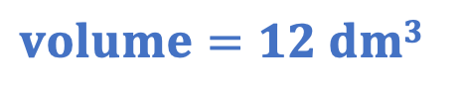
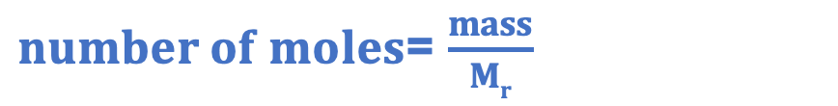
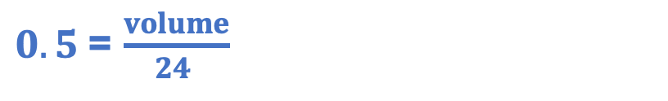

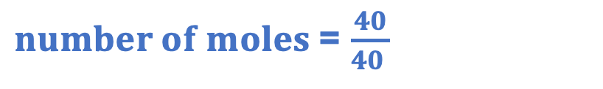
You: calculating volume of gas from an equation
Sodium hydroxide reacts with carbon dioxide according to the equation:
2 NaOH (s) + CO₂ (g) → Na₂CO₃ (s) + H₂O (l)
40 g of sodium hydroxide reacts completely with carbon dioxide. How many moles of sodium hydroxide react?
$number of moles$= $\frac{mass}{Mr}$
$number of moles$= $\frac{40}{40 }$
$$number of moles=1 mol$$
How many moles of carbon dioxide react?
Mole ratio = 2 : 1
number of moles of carbon dioxide = 0.5 mol
What volume of carbon dioxide reacts?
$number of moles$= $\frac{volume}{molar volume}$
$0.5$= $\frac{volume}{24 }$
$$volume=12 dm3$$
Notes:
Purpose: The I-We-You section aims to support pupils to build skills that they most commonly need when answering questions associated with this knowledge in the assessment. This section is also used to interleave other content we expect pupils to know at this stage of their education in order that they build a big picture of the science they are learning.
For the ‘I’ activity, the teacher should model how to answer the question. They can do this by narrating their thinking process aloud, and making links to learning earlier in the lesson explicit.
For the ‘we’ activity, the teacher and students work though a similar example together, in order to prepare students to be able to answer a similar question independently.
Opportunities for the ‘you’ activity – independent practise – occur in the activity portion of the lesson once the student is secure enough to process independently.

Slide 20
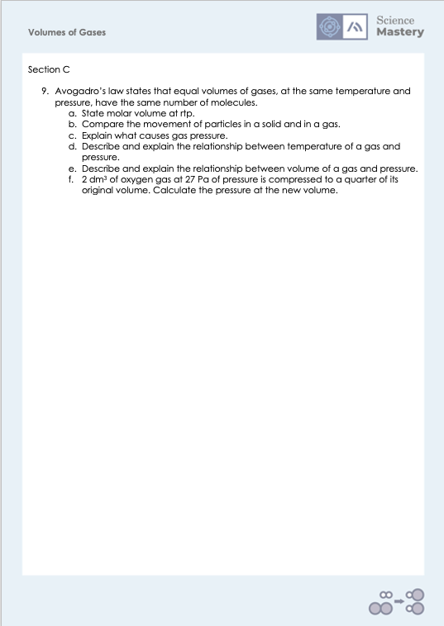
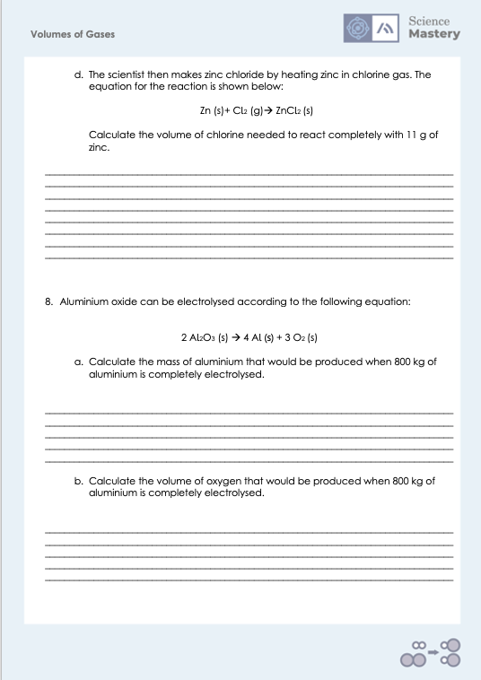
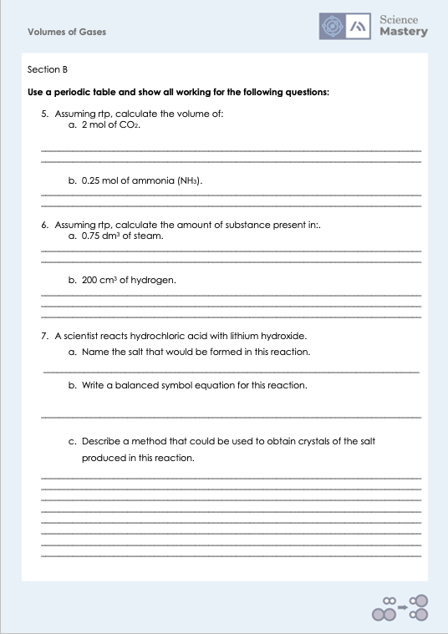
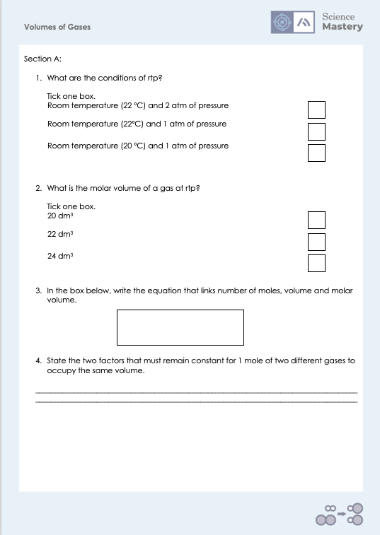
Activity

Slide 21
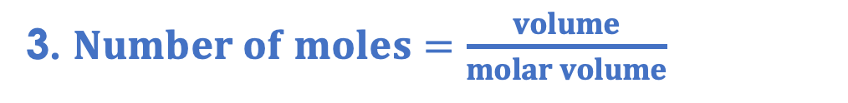
Answers
1. Room temperature (20 ºC) and 1 atm of pressure
2. 24 dm³
3. $Number of moles=\frac{volume}{molar volume}$
4. Temperature and pressure

Slide 22
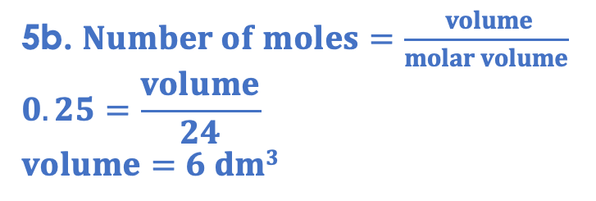
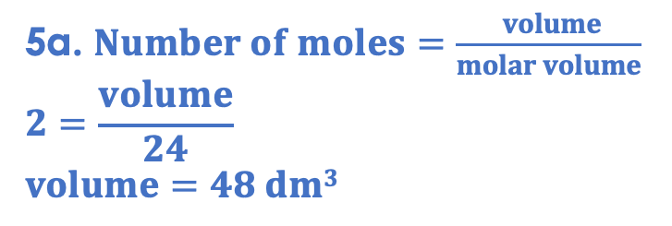
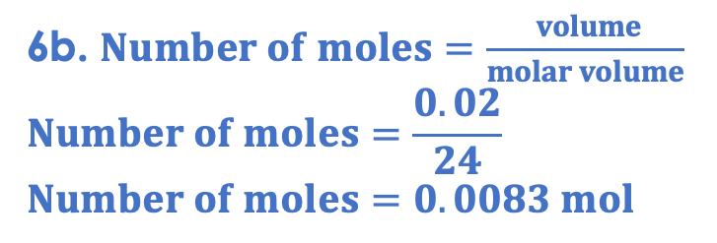
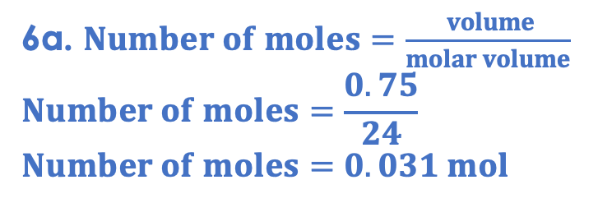
Answers
5a. $Number of moles=\frac{ volume}{molar volume}$
$$2=\frac{volume}{24}$$
$$volume=48 dm3$$
6a. $Number of moles=\frac{ volume}{molar volume}$
$$Number of moles=\frac{0.75}{24}$$
$$Number of moles=0.031 mol$$
5b. $Number of moles=\frac{ volume}{molar volume}$
$$0.25=\frac{volume}{24}$$
$$volume=6 dm3$$
6b. $Number of moles=\frac{ volume}{molar volume}$
$$Number of moles=\frac{0.02}{24}$$
$$Number of moles=0.0083 mol$$

Slide 23
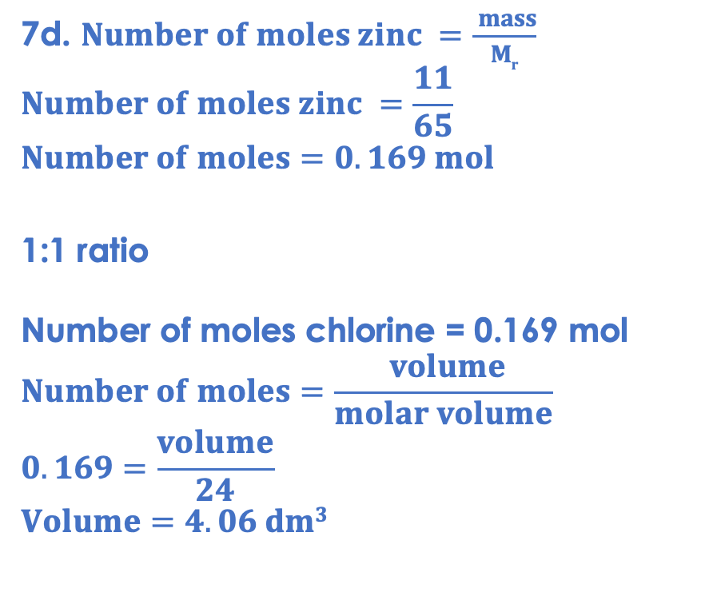
Answers
7d. $Number of moles zinc =\frac{ mass}{Mr}$
$$Number of moles zinc =\frac{11}{65}$$
$$Number of moles=0.169 mol$$
1:1 ratio
Number of moles chlorine = 0.169 mol
$$Number of moles=\frac{ volume}{molar volume}$$
$$0.169=\frac{volume}{24}$$
$$Volume=4.06 dm3$$
7a. lithium chloride
7b. HCl + LiOH → LiCl + H₂O
7c.
Add hydrochloric acid to a beaker and warm gently
Add spatulas full of lithium hydroxide until solid remains
Filter to remove solids
Evaporate gently over a Bunsen burner
Leave to crystallise

Slide 24
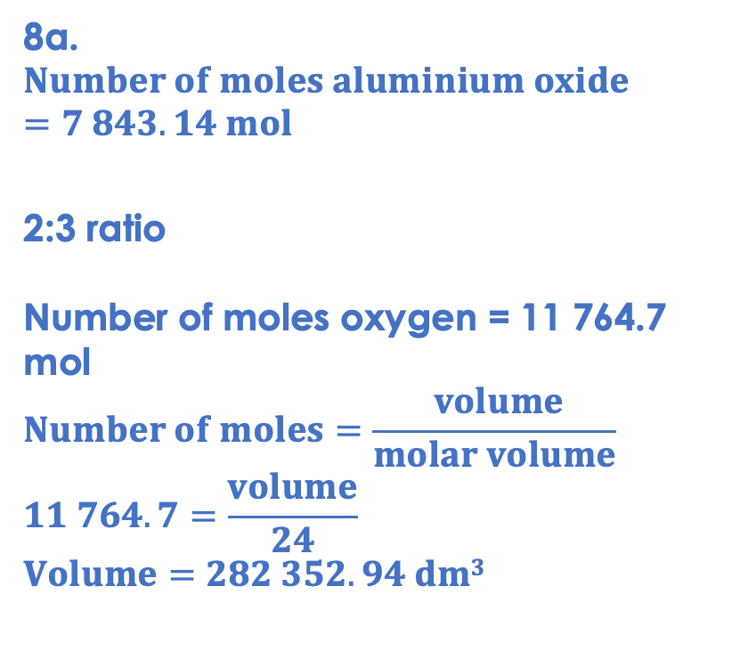
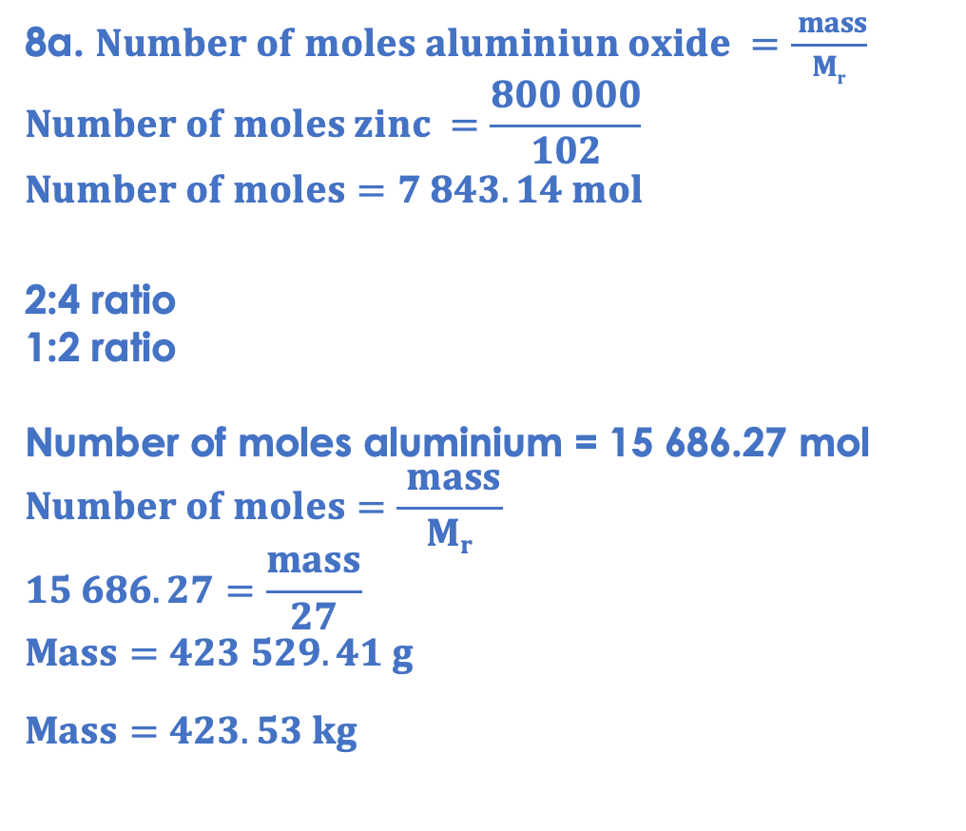
Answers
8a. $Number of moles aluminiun oxide =\frac{ mass}{Mr}$
$$Number of moles zinc =\frac{800 000}{102}$$
$$Number of moles=7 843.14 mol$$
2:4 ratio
1:2 ratio
Number of moles aluminium = 15 686.27 mol
$$Number of moles=\frac{ mass}{Mr}$$
$$15 686.27=\frac{mass}{27}$$
$$Mass=423 529.41 g$$
$$Mass=423.53 kg$$
8a.
$$Number of moles aluminium oxide=7 843.14 mol$$
2:3 ratio
Number of moles oxygen = 11 764.7 mol
$$Number of moles=\frac{ volume}{molar volume}$$
$$11 764.7=\frac{volume}{24}$$
$$Volume=282 352.94 dm3$$

Slide 25
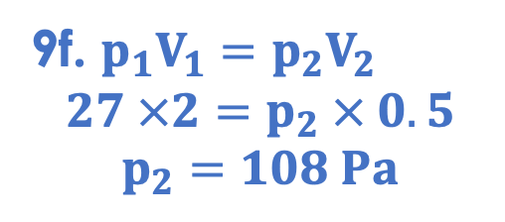
Answers
9a. 24 dm³
9b. Particles in a solid can only vibrate from fixed positions whereas particles in a gas can move freely and randomly in all directions.
9c. Gas pressure is caused by particles of a gas colliding with the walls of a container.
9d. As temperature increases, pressure of a gas increases as particles gain kinetic energy so collide with the walls of the container more frequently and with more force.
9e. As volume decreases, pressure of a gas increases as particles have less space to move around in so collide with walls of the container more frequently.
9f. $p_{1}V_{1}=p_{2}V_{2}$
$$27 ×2=p_{2} × 0.5$$
$$p_{2}=108 Pa$$

Slide 26
Answer the questions below.
What is the volume of one mole of gas at rtp?
A. 22 dm³
B. 24 dm³
C. 6.02 x 10²³ dm³
✓
Calculate the number of moles in 0.12 dm³ carbon dioxide gas at rtp.
A. 0.0027 mol
B. 0.005 mol
C. 200 mol
✓
What two factors must remain constant for 1 mole of two different gases to have the same volume?
A. Temperature and pressure
B. Temperature and mass
C. Pressure and mass
✓
Notes:
Q1. Answer: B
If students answer A, it suggests they have confused molar volume with the decimal places after Avogadro’s constant, which is a common mistake. If students answer C, they have confused volume with the amount of substance. To fix it, get students to explain the difference between volume and amount, and explain what is meant by the molar volume.
Q2. Answer: B
If students answer A, they have divided volume by Mr, confusing the equations for volume and mass. If students answer C, they have divided molar volume by the given volume. To fix it, remind students of the correct equation that links volume, number of moles and molar volume. Model the method to work this calculation out, and then give the student some similar calculations to try.
Q3. Answer: A
If students answer B or C, they have the misconception that because two gases may have the same mass, they will have the same volume. To fix it, review the relationship between mass and number of moles, showing students that 1 mole of two different gases may not have the same mass, but will still occupy the same volume.

Slide 27
Lesson C4.3.15
What was good about this lesson? | What can we do to improve this lesson?
Send us your feedback by clicking this link
or by emailing sciencemastery@arkonline.org
Thank you!

